Slide 1
.net III
CLOSE OUT REPORT
© 2017 Kirkwood Community College, All Rights Reserved

Slide 2
CONTENTS
Project Summary
Problem
Project Team
Project Structure
© 2017 Kirkwood Community College, All Rights Reserved

Slide 3
PROJECT TEAM
Michael Takrama, Student
Sir. Jim Glasgow, Instructor
© 2017 Kirkwood Community College, All Rights Reserved
© 2017 Kirkwood Community College, All Rights Reserved

Slide 4
THE PROBLEM
© 2017 Kirkwood Community College, All Rights Reserved

Slide 5
THE PROBLEM
Disjoint Efforts
Too Many Applications
Uncertainty
© 2017 Kirkwood Community College, All Rights Reserved

Slide 6
THE OBJECTIVE
© 2017 Kirkwood Community College, All Rights Reserved

Slide 7
THE OBJECTIVE
Powerful Forecasting Tool
Data from User Interaction (Clicks, Pauses, Heavy Weight Nodes)
Integrated Apps (Sales, Jobs, Meetings)
Insights (Data Mining)
© 2017 Kirkwood Community College, All Rights Reserved

Slide 8
PROJECT
SUMMARY
© 2017 Kirkwood Community College, All Rights Reserved

Slide 9
PROJECT SUMMARY
Project Name
SCSYSTEM
Primary Function
Enterprise Software Platform
::Platform Administration for Multiple Apps
© 2017 Kirkwood Community College, All Rights Reserved

Slide 10
© 2017 Kirkwood Community College, All Rights Reserved

Slide 11
SOFTWARE
ARCHITECTURE
© 2017 Kirkwood Community College, All Rights Reserved

Slide 12
Program Architecture
Project Name : .NET II (KSManPro)
N-TIER SOFWARE ARCHITECTURE
© 2017 Kirkwood Community College, All Rights Reserved

Slide 13
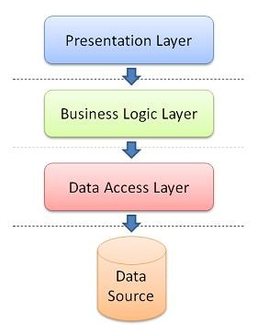
Credit: morecoding.wordpress.com
© 2017 Kirkwood Community College, All Rights Reserved

Slide 14
Program Features
Project Name : .NET III (SCSYSTEM – ASP.NET MVC 5)
ONION ARCHITECTURE
© 2017 Kirkwood Community College, All Rights Reserved

Slide 15
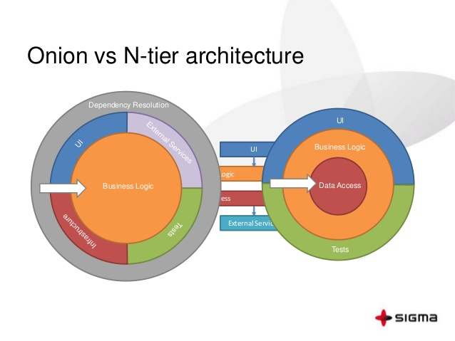
Credit: Sigma
© 2017 Kirkwood Community College, All Rights Reserved

Slide 16
SOFTWARE DESIGN
© 2017 Kirkwood Community College, All Rights Reserved

Slide 17
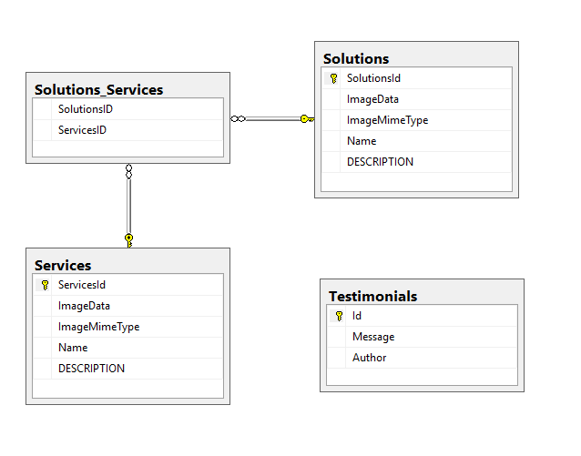
Software Design – Schema(scysysdb)
© 2017 Kirkwood Community College, All Rights Reserved

Slide 18
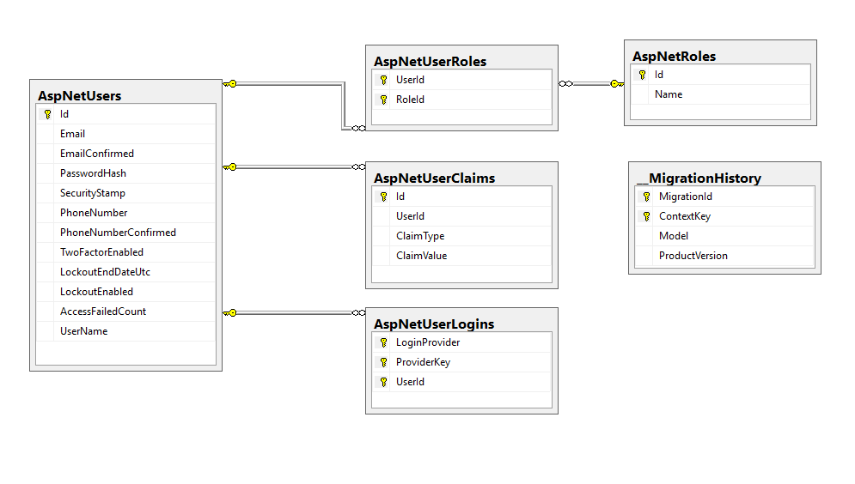
Software Design – Schema(Identity Tables)
© 2017 Kirkwood Community College, All Rights Reserved

Slide 19

KIRKWOOD COMMUNITY COLLEGE
THANK YOU
6301 KIRKWOOD BLVD SW
CEDAR RAPIDS, 52404
© 2017 Kirkwood Community College, All Rights Reserved

